Slide 1

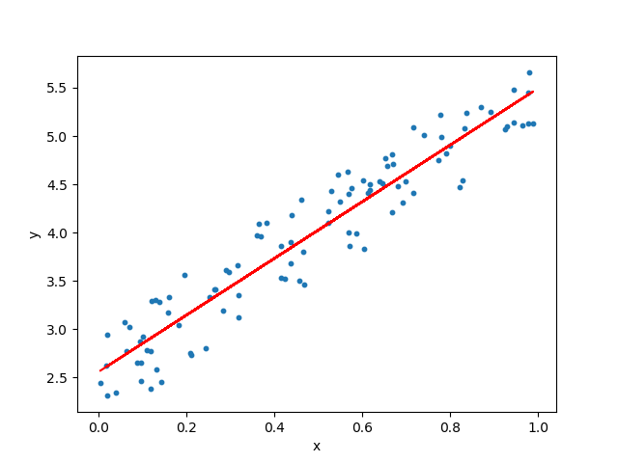
MCSE0007: Machine Learning
Linear Regression
Class Presentations on Machine Learning by Prof. Anand Singh Jalal

Slide 2
Regression Models
Relationship between one dependent variable and explanatory variable(s)
Use equation to set up relationship
Numerical Dependent (Response) Variable
1 or More Numerical or Categorical Independent (Explanatory) Variables
Used Mainly for Prediction & Estimation
Notes:
Regression is a statistical measurement that attempts to determine the strength of the relationship between one dependent variable (usually denoted by Y) and a series of other changing variables (known as independent variables).

Slide 3
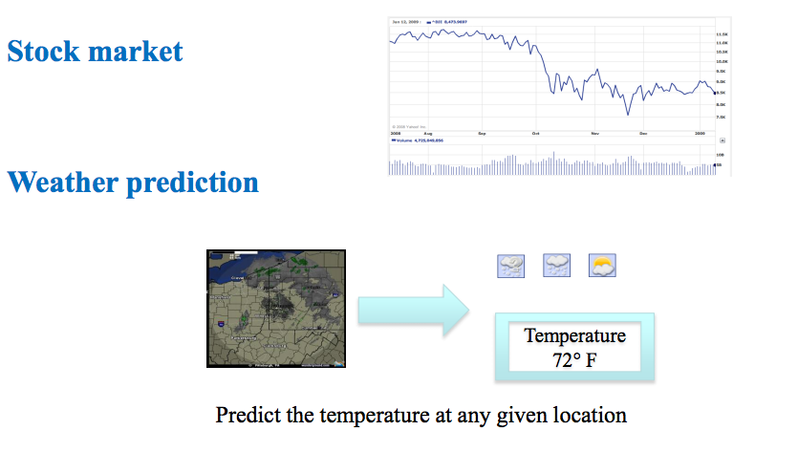
Regression Examples

Slide 4
Linear Equations

Slide 5
Simple Linear Regression Equation
Positive Linear Relationship
E(y)
Regression line
Intercept
β₀
Slope β₁
is positive
x

Slide 6
Simple Linear Regression Equation
Negative Linear Relationship
E(y)
Intercept
β₀
Regression line
Slope β₁
is negative
x
Notes:
Value of y decreases as value of x increases

Slide 7
Simple Linear Regression Equation
No Relationship
E(y)
Intercept
β₀
Regression line
Slope β₁
is 0
x

Slide 8
Linear Regression
Given an input x we would like to compute an output y
For example:
- Predict height from age
- Predict House price from its Area
- Predict distance from wall from sensors
Y
X

Slide 9
Linear Regression …
Given an input x we would like to compute an output y
In linear regression we assume that y and x are related with the following equation:
y = wx+ε
where w is a parameter and ε represents measurement or other noise
Y
Observed values
What we are trying to predict
X

Slide 10
Linear Regression Model (Estimation Process)
Regression Model
y = β₀ + β₁x +ε
Regression Equation
E(y) = β₀ + β₁x
Unknown Parameters
β₀, β₁
Sample Data:
x y
x₁ y₁
. .
. .
x_{n} y_{n}
b₀ and b₁
provide estimates of
β₀ and β₁
Estimated
Regression Equation
Sample Statistics
b₀, b₁

Slide 11
Linear Regression Model (Estimation Process)
Population
Random Sample
Unknown Relationship
☺
☺
☺
☺
☺
☺
☺

Slide 12
Linear Regression Model (Estimation Process)
Population
Random Sample
Unknown Relationship
☺
☺
☺
☺
☺
☺
☺

Slide 13
Linear Regression Model (Estimation Process)
Observedvalue
ε_{i} = Random error
Observed value

Slide 14
Linear Regression Model (Estimation Process)
ε_{i} = Random error
^
Unsampled observation
Observed value

Slide 15
Linear Regression Model … (Estimating Parameters)
1. Plot of All (X_{i}, Y_{i}) Pairs
2. Suggests How Well Model Will Fit
Y
60
40
20
0
X
0
20
40
60

Slide 16
Linear Regression Model … (Estimating Parameters)
How would you draw a line through the points? How do you determine which line ‘fits best’?
Y
60
40
20
0
X
0
20
40
60

Slide 17
Linear Regression Model … (Estimating Parameters)
How would you draw a line through the points? How do you determine which line ‘fits best’?
Slope changed
Y
60
40
20
0
X
0
20
40
60
Intercept unchanged

Slide 18
Linear Regression Model … (Estimating Parameters)
How would you draw a line through the points? How do you determine which line ‘fits best’?
Slope unchanged
Y
60
40
20
0
X
0
20
40
60
Intercept changed

Slide 19
Linear Regression Model … (Estimating Parameters)
How would you draw a line through the points? How do you determine which line ‘fits best’?
Slope changed
Y
60
40
20
0
X
0
20
40
60
Intercept changed

Slide 20
Linear Regression: Cost Model (Least Squares Method)
Determine which line ‘fits best’?
‘Best Fit’ Means Difference Between Actual Y Values & Predicted Y Values Are a Minimum.
But Positive Differences Off-Set Negative ones
So square errors!

Slide 21
Linear Regression: Cost Model … (Least Squares Method)
Least Squares minimizes the Sum of the Squared Differences (errors) (SSE)
Least Squares Criterion
where:
y_{i} = observed value of the dependent variable
for the ith observation
^
y_{i} = estimated value of the dependent variable
for the ith observation

Slide 22
Linear Regression: Cost Model … (Least Squares Method)

Slide 23
Reminder: Notation
Training set of
housing prices
(Portland, OR)
Size in feet² (x) | Price ($) in 1000's (y)
2104 | 460
1416 | 232
1534 | 315
852 | 178
… | …
Notation:
m = Number of training examples
x’s = “input” variable / features
y’s = “output” variable / “target” variable

Slide 24
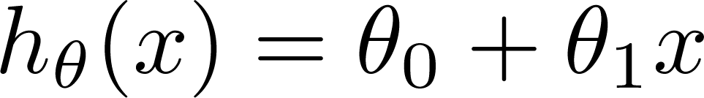
Learning algorithm
for hypothesis function h
Training Set
Learning Algorithm
Linear Hypothesis:
Size of house
h
Estimate price
Univariate linear regression)

Slide 25

Linear Regression: Cost Function
Size in feet² (x) | Price ($) in 1000's (y)
2104 | 460
1416 | 232
1534 | 315
852 | 178
… | …
Training Set
Hypothesis:
‘s:Parameters
How to choose ‘s ?

Slide 26
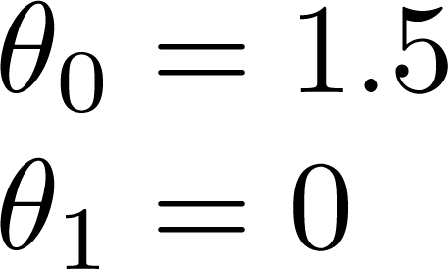
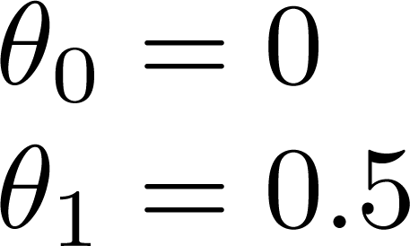
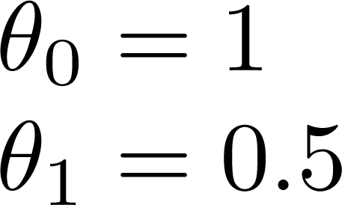
Linear Regression: Cost Function

Slide 27
Linear Regression: Cost Function

Slide 28
Idea:
Choose θ₀ ,θ₁ so that h_{θ} (x) is close to y for our training examples
What are good measures of being “close”?

Slide 29
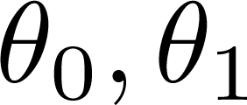
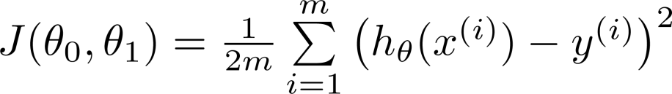
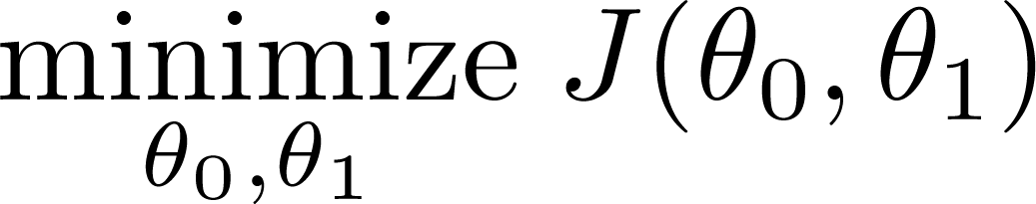
Linear Regression Model …
Hypothesis:
Parameters:
Cost Function:
Goal:

Slide 30
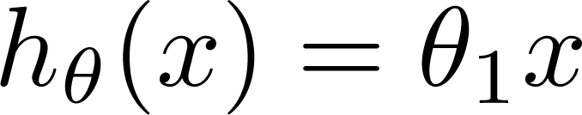

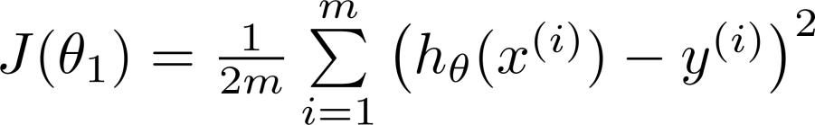
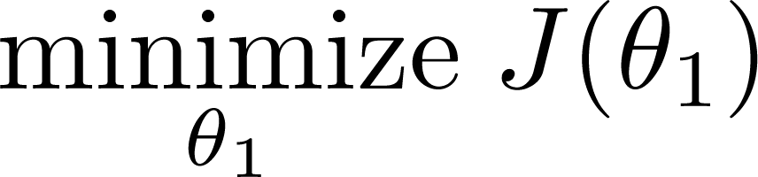
Linear Regression Model …
Hypothesis:
Simplified
θ₀ = 0
Parameters:
Cost Function:
Goal:

Slide 31






θ₀ = 0
(for fixed θ₁ this is a function of x)
(function of the parameter θ₁ )
y
x
h_{θ} (x) = x

Slide 32

θ₀ = 0
(for fixed θ₁ this is a function of x)
(function of the parameter θ₁ )
y
x
h_{θ} (x) = 0.5x

Slide 33

θ₀ = 0
(for fixed θ₁ this is a function of x)
(function of the parameter θ₁ )
y
x
h_{θ} (x) = 0

Slide 34
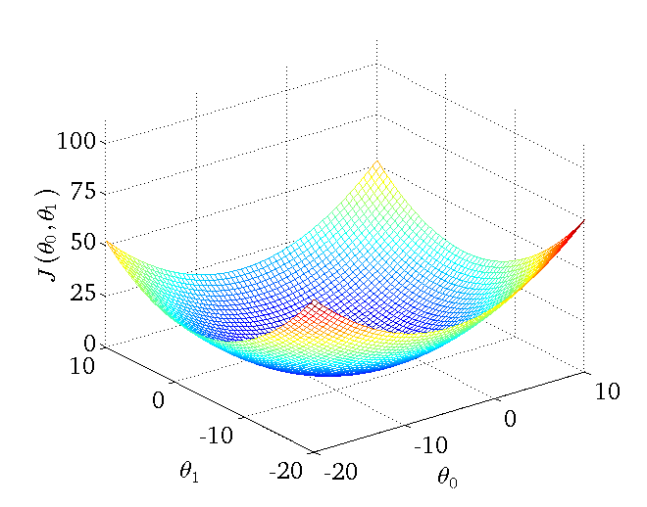
Linear Regression: Cost Function

Slide 35
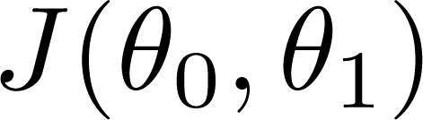


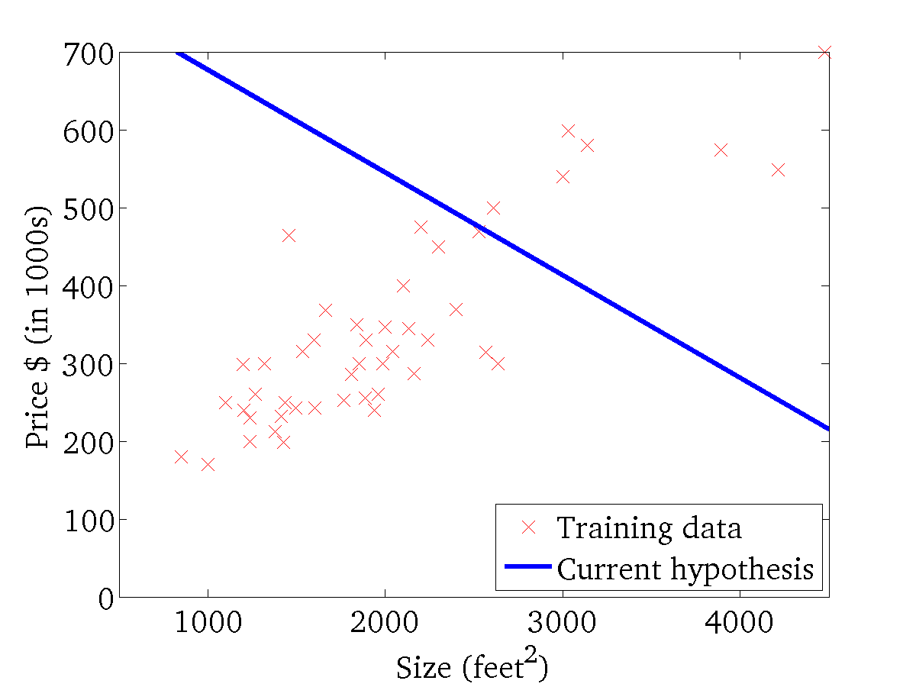
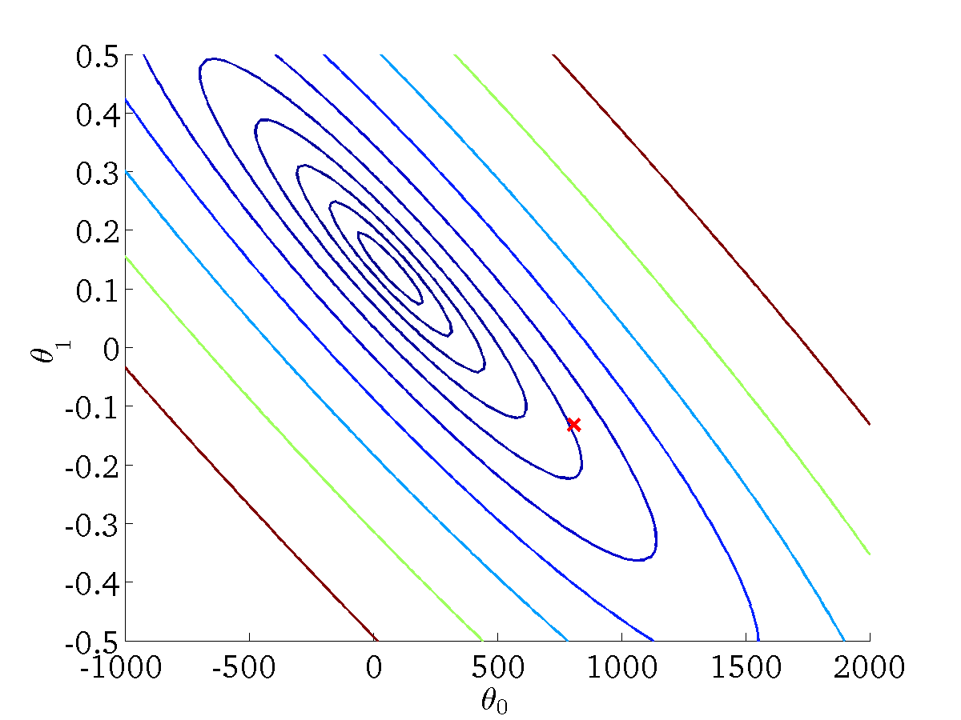
Linear Regression: Cost Function …
(for fixed , this is a function of x)
(function of the parameters )

Slide 36
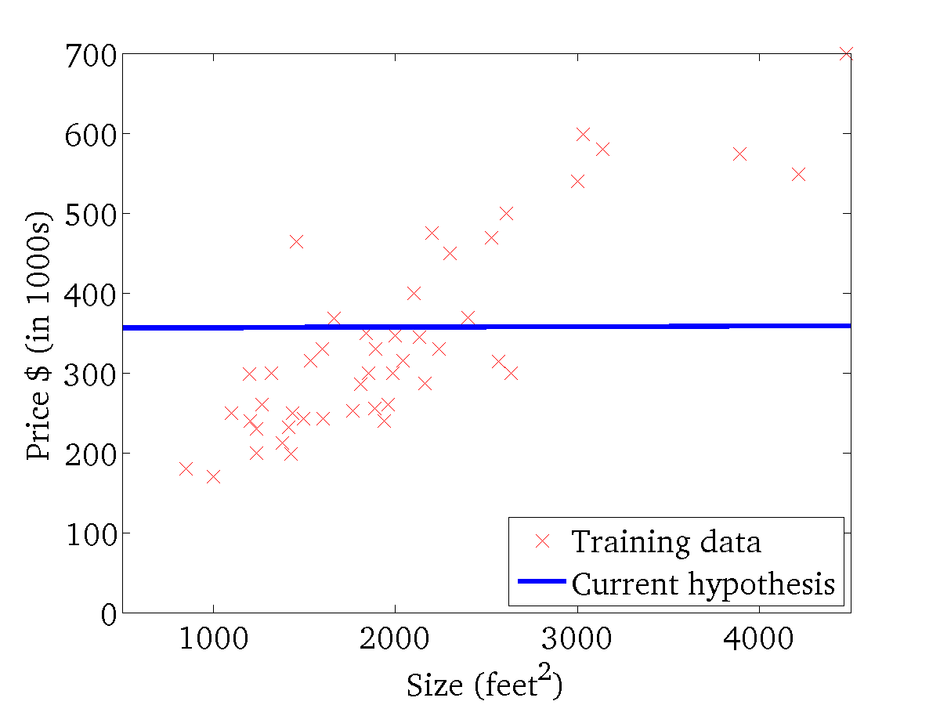
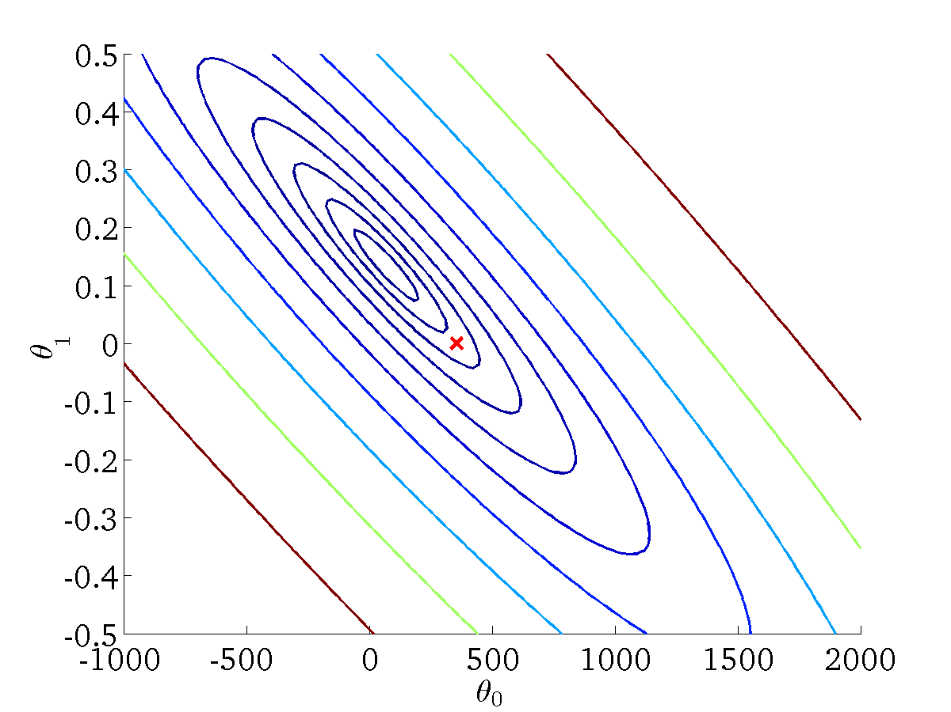
Linear Regression: Cost Function …
(for fixed , this is a function of x)
(function of the parameters )

Slide 37
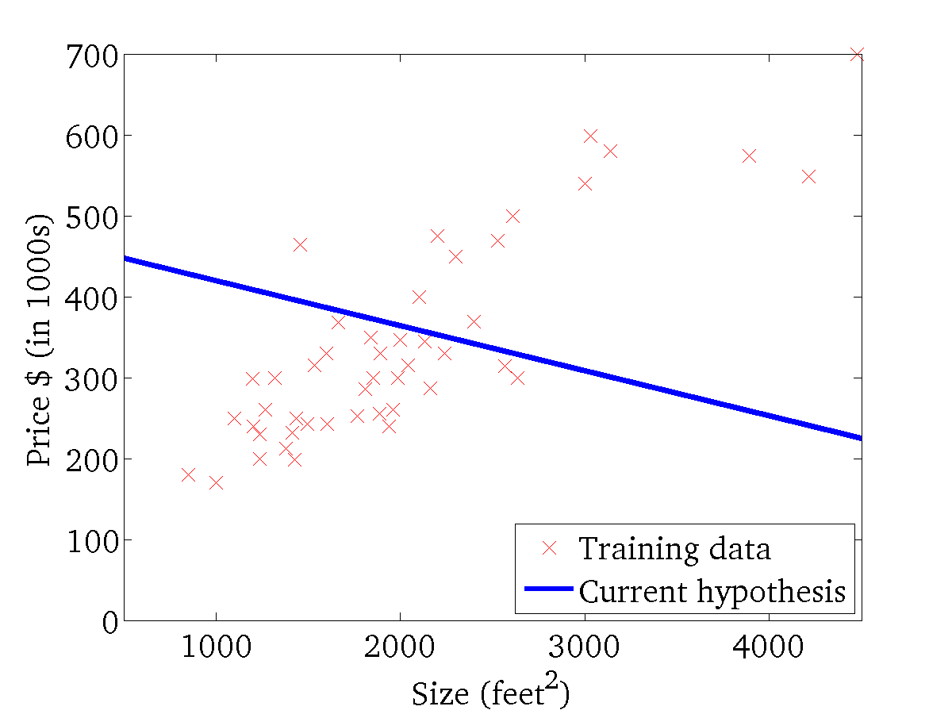

Linear Regression: Cost Function …
(for fixed , this is a function of x)
(function of the parameters )

Slide 38
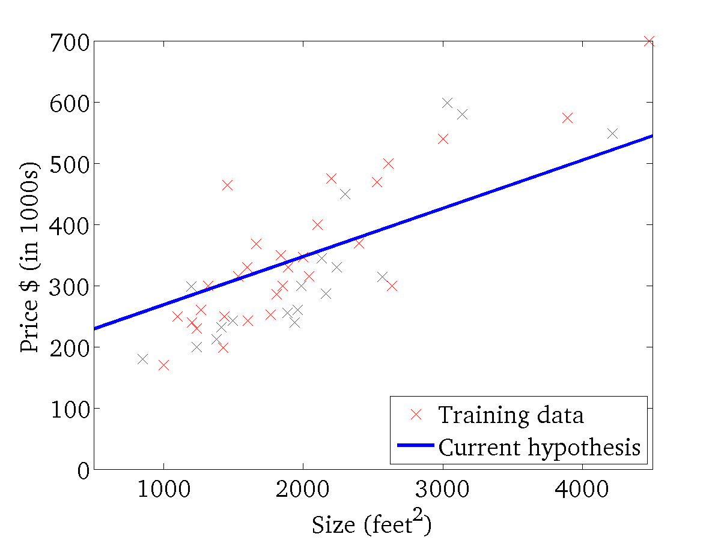
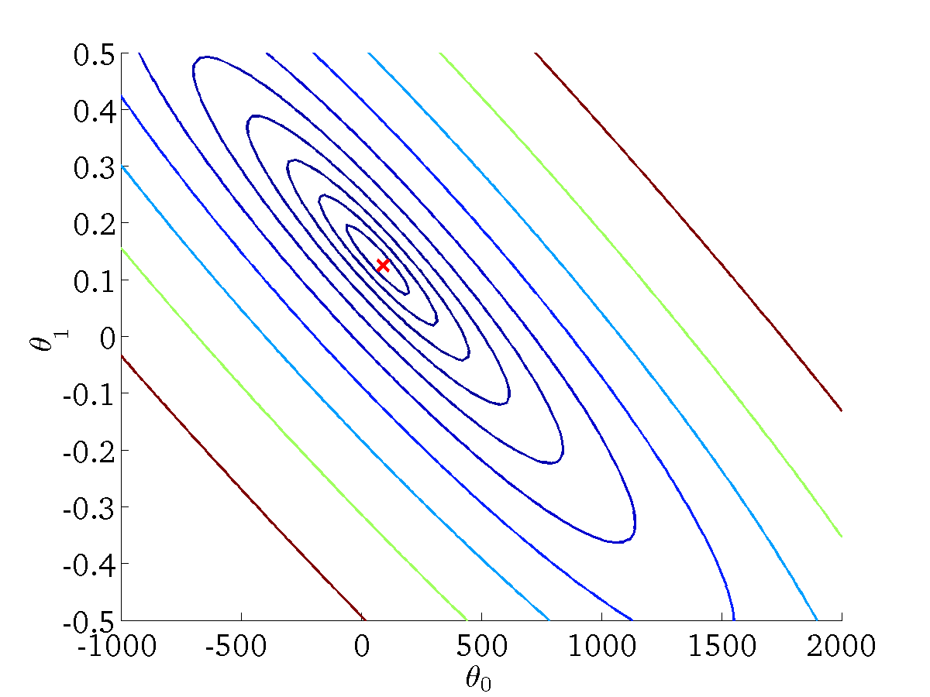
Linear Regression: Cost Function …
(for fixed , this is a function of x)
(function of the parameters )

Slide 39
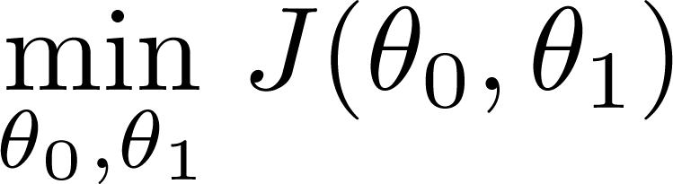
Linear Regression: Cost Function …
Have some function
Want
Outline:
Start with some
Keep changing to reduce until we hopefully end up at a minimum

Slide 40
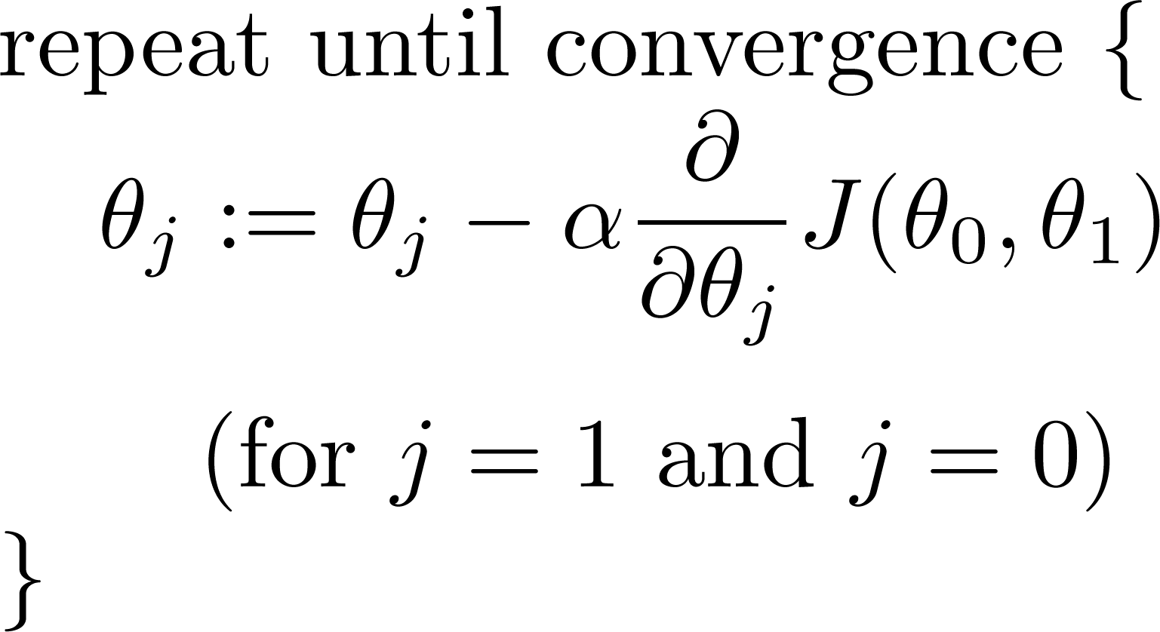
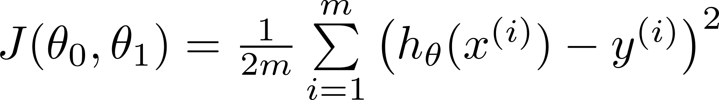
Gradient Descent Algorithm for Linear Univariate Regression
Gradient descent algorithm
Linear Regression Model

Slide 41
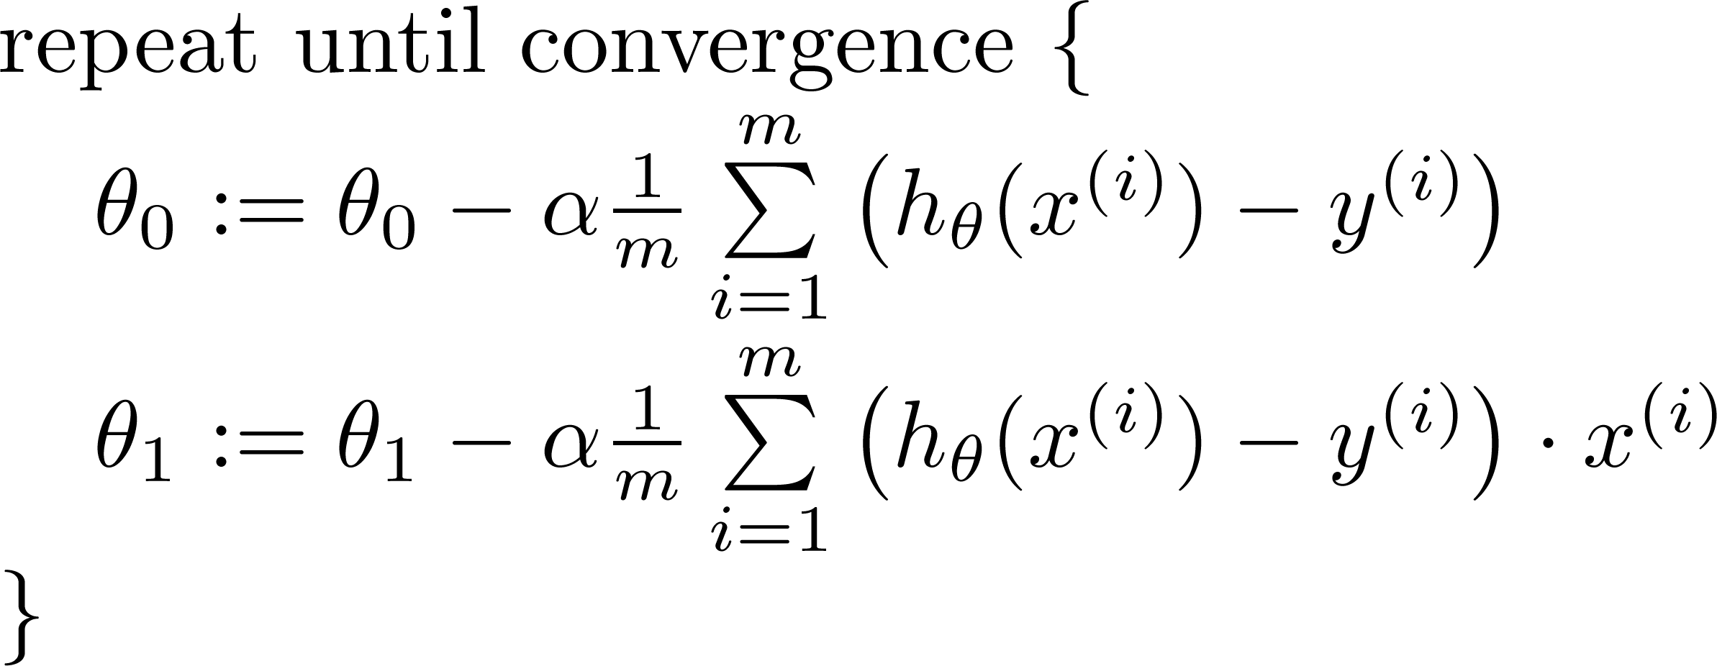

Gradient Descent Algorithm for Linear Univariate Regression …
update
and
simultaneously
learning rate

Slide 42
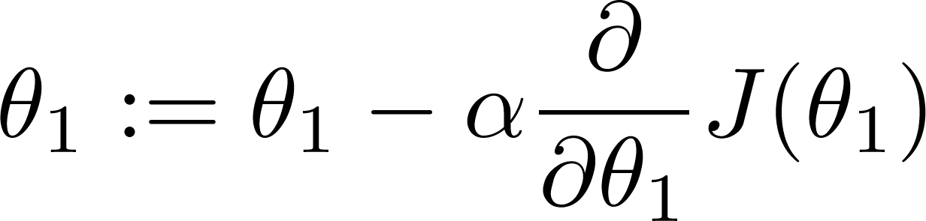
If α is too small, gradient descent can be slow.
If α is too large, gradient descent can overshoot the minimum. It may fail to converge, or even diverge.

Slide 43
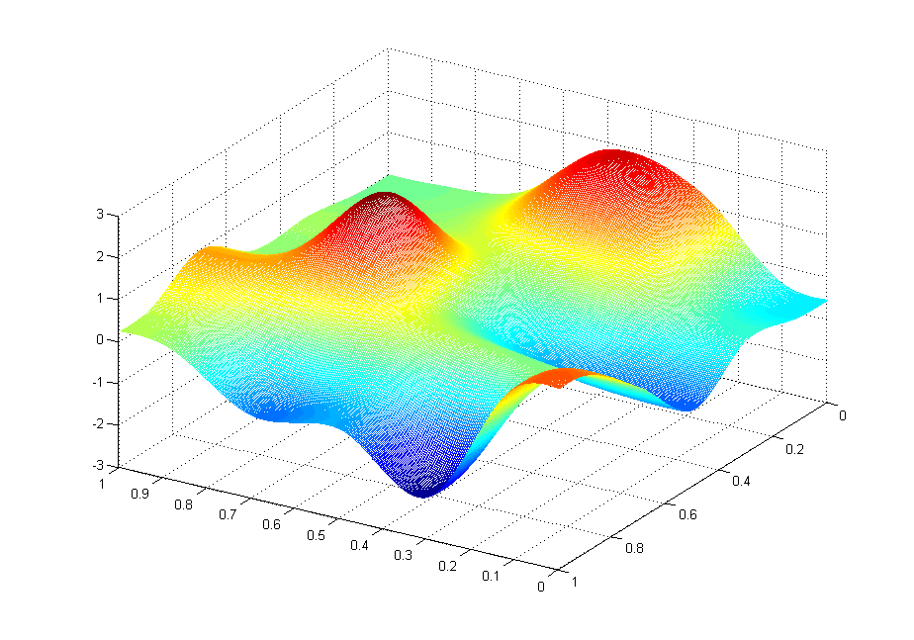
Gradient Descent Algorithm for Linear Univariate Regression …
J(θ₀,θ₁)
θ₁
θ₀

Slide 44
Gradient Descent Algorithm for Linear Univariate Regression …
J(θ₀,θ₁)
θ₁
θ₀

Slide 45
Quiz
Consider the problem of predicting how well a student does in her second year of college/university, given how well she did in her first year.
Specifically, let x be equal to the number of "A" grades (including A-. A and A+ grades) that a student receives in their first year of college (freshmen year). We would like to predict the value of y, which we define as the number of "A" grades they get in their second year (sophomore year).
Here each row is one training example. Recall that in linear regression, our hypothesis is hθ(x)=θ0+θ1x, and we use m to denote the number of training examples.
x y
5 4
3 4
0 1
4 3
For the training set given above (note that this training set may also be referenced in other questions in this quiz), what is the value of m? In the box below, please enter your answer (which should be a number between 0 and 10).
Notes:
Ans 4

Slide 46
Quiz …
Consider the following training set of m=4 training examples:
x y
1 0.5
2 1
4 2
0 0
Consider the linear regression model hθ(x)=θ0+θ1x. What are the values of θ0 and θ1 that you would expect to obtain upon running gradient descent on this model? (Linear regression will be able to fit this data perfectly.)
θ0=0.5,θ1=0
θ0=0.5,θ1=0.5
θ0=1,θ1=0.5
θ0=0,θ1=0.5
θ0=1,θ1=1
Notes:
Answer:
θ0=0,θ1=0.5
As J(θ0,θ1)=0, y = hθ(x) = θ0 + θ1x. Using any two values in the table, solve for θ0, θ1.

Slide 47
Quiz …
Suppose we set θ₀=−1,θ₁=0.5. What is h_{θ}(4)?
Notes:
Answer:
Setting x = 4, we have h_{θ}(x)=θ₀+θ₁x = -1 + (0.5)(4) = 1

Slide 48
Quiz …
Let f be some function so that f(θ0,θ1) outputs a number. For this problem,
f is some arbitrary/unknown smooth function (not necessarily the cost function of linear regression, so f may have local optima).
Suppose we use gradient descent to try to minimize f(θ0,θ1) as a function of θ0 and θ1. Which of the following statements are true? (Check all that apply.)
Even if the learning rate α is very large, every iteration of gradient descent will decrease the value of f(θ0,θ1).
If the learning rate is too small, then gradient descent may take a very long time to converge.
If θ0 and θ1 are initialized at a local minimum, then one iteration will not change their values.
If θ0 and θ1 are initialized so that θ0=θ1, then by symmetry (because we do simultaneous updates to the two parameters), after one iteration of gradient descent, we will still have θ0=θ1.
Notes:
True - If the learning rate is too small, then gradient descent may take a very long time to converge. (If the learning rate is small, gradient descent ends up taking an extremely small step on each iteration, and therefor can take a long time to converge)
True - If θ₀ and θ₁ are initialized at a local minimum, then one iteration will not change their values. (At a local minimum, the derivative (gradient) is zero, so gradient descent will not change the parameters.)
False - Even if the learning rate α is very large, every iteration of gradient descent will decrease the value of f(θ₀,θ₁). (If the learning rate is too large, one step of gradient descent can actually vastly "overshoot" and actually increase the value of f(θ₀,θ₁).)
False - If θ₀ and θ₁ are initialized so that θ₀=θ₁, then by symmetry (because we do simultaneous updates to the two parameters), after one iteration of gradient descent, we will still have θ₀=θ₁. (The updates to θ₀ and θ₁ are different (even though we're doing simulaneous updates), so there's no particular reason to update them to be same after one iteration of gradient descent.)

Slide 49
Quiz …
Suppose that for some linear regression problem (say, predicting housing prices as in the lecture), we have some training set, and for our training set we managed to find some θ0, θ1 such that J(θ0,θ1)=0.
Which of the statements below must then be true? (Check all that apply.)
For this to be true, we must have y(i)=0 for every value of i=1,2,…,m.
Gradient descent is likely to get stuck at a local minimum and fail to find the global minimum.
For this to be true, we must have θ0=0 and θ1=0 so that hθ(x)=0
Our training set can be fit perfectly by a straight line, i.e., all of our training examples lie perfectly on some straight line.
Notes:
False - For this to be true, we must have y^{(i)}=0 for every value of i=1,2,…,m. (So long as all of our training examples lie on a straight line, we will be able to find θ₀ and θ₁) so that J(θ₀,θ₁)=0. It is not necessary that y^{(i)} for all our examples.)
False - Gradient descent is likely to get stuck at a local minimum and fail to find the global minimum. (none)
False - For this to be true, we must have θ₀=0 and θ₁=0 so that h_{θ}(x)=0 –( If J(θ₀,θ₁)=0 that means the line defined by the equation "y = θ₀ + θ₁x" perfectly fits all of our data. There's no particular reason to expect that the values of θ₀ and θ₁ that achieve this are both 0 (unless y^{(i)}=0 for all of our training examples).
True - Our training set can be fit perfectly by a straight line, i.e., all of our training examples lie perfectly on some straight line. (None)

Slide 50

Any Questions ?

